Slide 1
Kinship, Parental Manipulation and Evolutionary Origins of Eusociality
Hee Jin, Brooke, Bridget, Chris, Chia-Mei

Slide 2
Introduction
A eusocial species is one in which large quantities of offspring, in an attempt to help their queen mother produce more siblings, relinquish most or all of their own direct reproductivity.
The benefit of this alleged altruistic behavior to workers exists only if gains in indirect fitness associated with raising siblings outweigh the costs, which is often a complete loss of direct fitness.
Maternal behavior is predicted to play a crucial role in driving the eusocial evolution. This is due to the significant fitness benefits gained by the queens when they succeeded in manipulating their daughters into becoming helpers.
If the fitness gains for the queen are large enough, maternal manipulation will be sufficient to evolve eusociality despite the lack of net inclusive fitness benefits to workers.

Slide 3
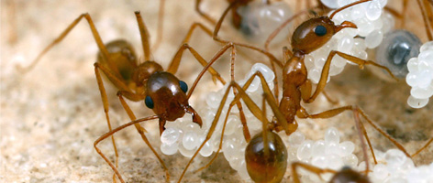
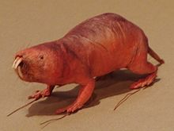
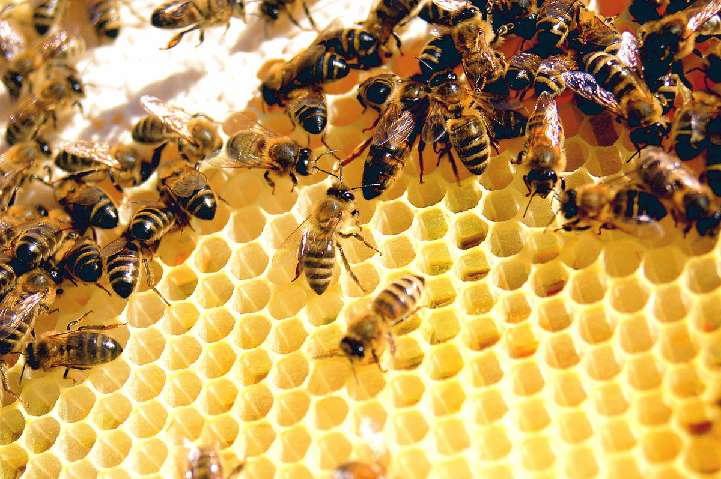
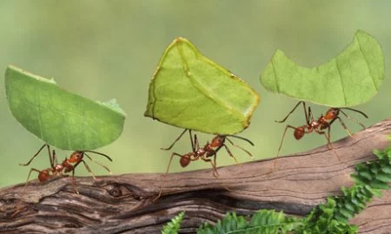
Eusociality
Division of labor in which…
Workers are in charge of foraging
Workers feed the queen
Workers do not mate
Workers do not lay eggs
Workers have lower juvenile hormone levels
Possible evolutionary origins:
Maternal Manipulation
Worker Altruism

Slide 4
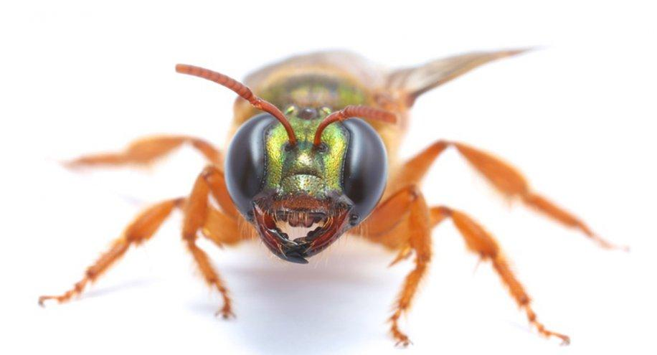
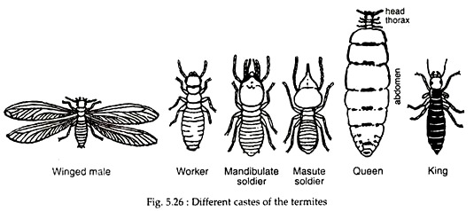
Goals & Hypothesis
The goal of the study was to investigate the ways in which eusociality evolves in natural populations. This was done by measuring the inclusive fitness of the facultatively eusocial sweat bee (Megalopta genalis) in order to quantify the direct fitness costs to workers in comparison to the benefits gained by the queens.
The hypothesis was that eusociality may evolve without direct net fitness benefit to workers.
https://www.science.lu.se/article/how-bees-find-their-way-home

Slide 5
Methods
In terms of actual field data, observational nests were arranged in seven clusters of 10-15 nests each across 1500 ha. Variation, in terms of nest conditions, seasonal effects, and local resource availability, was thus reduced. This was done in order to avoid influence in terms of reproductive success and social behavior.
Behavioral and genetic data were applied to the Inclusive Fitness calculations which were calculated on an individual basis. For each founder and worker, two estimations of Inclusive Fitness were obtained under either one of two assumptions: either the daughter genotype or the foundress genotype are responsible for all social interactions.
Computer simulations were designed with the intention of creating conditions which give rise to eusocial behaviors using field data. Initially, the likelihood of having either sex offspring is arranged to be 50:50, until sex-biasing alleles are later introduced. In addition, the maternal manipulation begins as a mutant allele which is allowed to spread during the course of the experiment. Data is recorded for 10,000 generations and all simulations are repeated 50 times.

Slide 6
Inclusive Fitness Calculations
I_{F}= (G_{n} x r_{o}) + (G_{s} x r_{o}) + (G_{o} x r_{r})
G_{n} = fitness effects of each individual’s genotype through nonsocial traits
G_{s} = fitness effects of each individual’s genotype through social traits
G_{o} = fitness effects of each individual’s genotype on offspring of others
r_{o}=relatedness to one’s own offspring
r_{r}=relatedness to the offspring of those receiving fitness effects

Slide 7
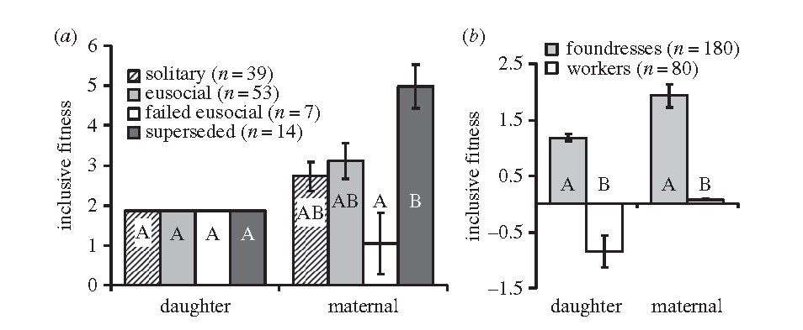
Field Data Results
For females that reared offspring
For foundresses and workers
Kapheim et al. 2005
If eusociality was based on the daughter’s genotype, inclusive fitness would be the same regardless of outcome & foundresses would have higher fitness than workers
If eusociality was based on the mother’s genotype, inclusive fitness would be highest for superseded colonies and lowest for failed eusocial & foundresses would have highest fitness
Notes:
Foundresses ALWAYS do better than their daughters
Daughters do better w eusociality when mother genotype is responsible
Workers have lower inclusive fitness than those with nests
Foundresses that recruit workers have similar fitness to solitary foundresses
When maternal genotype is responsible for manipulation, working is your best option and least selected against → evolutionary mechanism for eusociality to evolve

Slide 8
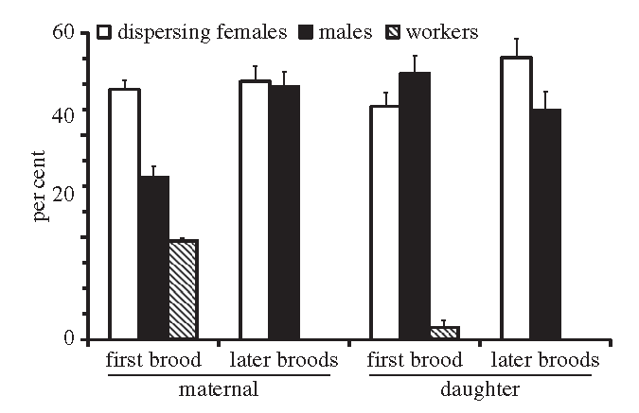
Simulation Model Results
Field data matches maternal
Maternal genotype: high percentage of workers initially, not later
Daughter genotype: high numbers of males in first and later broods; lower number of workers
Kapheim et al. 2005
Notes:
Under maternal manipulation, many more females than males initially, many more males later. Under daughter, not exactly. Field data matches maternal.

Slide 9
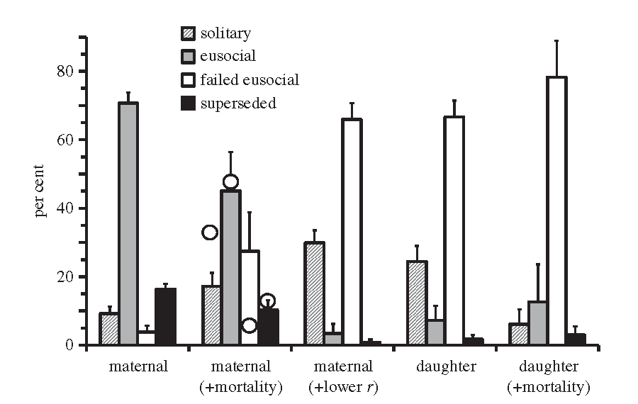
Simulation Model Results
Maternal: eusocial will prevail
Maternal w/ increased mortality: eusocial will again prevail
Maternal w/ less relatedness: failed eusocial is most common
Daughter: failed eusocial is again most common
Daughter w/ increased mortality: failed eusocial is again most common
1 2 3 4 5
Kapheim et al. 2005
Notes:
Eusociality is very unlikely to evolve in cases 3-5
Case 3 suggests that relatedness is an important factor in eusociality development
Case 4-5 suggest that daughter genotype unlikely to lead to evolution of eusociality
Best fit with field data is case 2, so most likley to have evolved in this way

Slide 10
Conclusion
Eusociality is able to evolve through two methods:
a) parental manipulation
b) worker altruism
Workers did not significantly increase their inclusive fitness by helping
Parental manipulation is needed to encourage eusocial behavior
When assuming that maternal genotype is in control of social structure, eusociality did not significantly increase inclusive fitness
May explain why eusociality is facultative in this species
Alternative life histories coexist in this species (eusociality and solitary modes of reproduction)
Kin selection is important

Slide 11
Discussion
What were some of the goals of this paper?
Which evidence did you feel proved the authors’ points the best: field data or simulation data? Why?
Are these findings of the evolutionary mechanisms of eusociality applicable to other species? What are the implications of their findings?
What did you find to be particular strengths of this paper? What about weaknesses?
What aspects of this paper could be controversial in the field? Genetic relatedness? Maternal manipulation?
What are the proximate vs ultimate causes of eusociality?
Notes:
To determine the mechanisms underlying the expression of eusociality, shed light on evolutionary origins, generalize this process to maybe later to applied to other study organisms, etc.
The combination of the field data and the simulation data: field data is good for getting actual results with the organism but also has limitations in sample size. Simulation data is good for having a large sample size and running several thousands of trials, but also are simulations so may not accurately represent the actual behavior
Facultative eusociality evolved once… why not again? It’s already present in many species (bees, ants, naked mole rats, etc). Eusociality evolves when there is a high degree of genetic relatedness, and most easily evolves from maternal manipulation, can evolve from worker altruism but less likely
Strengths: combination of field data and simulation data, the fact that they used an organism that has the choice to be eusocial or solitary. Weaknesses: method of maternal manipulation, limit of study size from taking nests out for observation at different points in study
Genetic relatedness was shown to be not necessary in other studies, necessary in this study, debate between scientists. Maternal manipulation was shown to be more likely but they didn’t elaborate on the method of manipulation.
Proximate: maternal manipulation genotype (pheromones, aggressive behavior, size, food withholding, etc) Ultimate: fitness of genotype- even if you as an individual may not reproduce, your relatives will reproduce and pass on the genes.

Slide 12
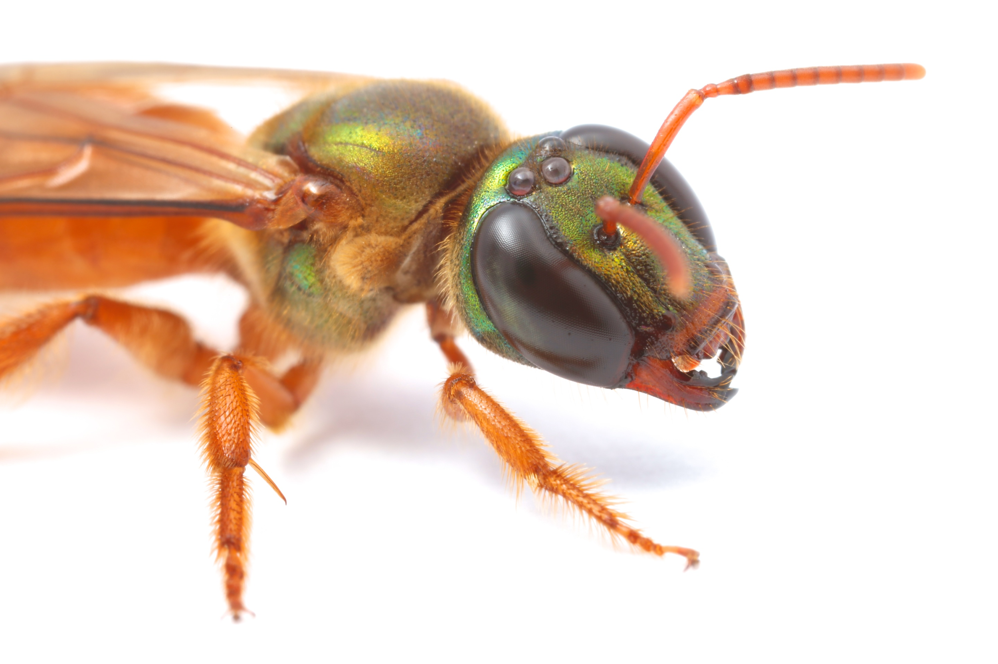
Wanna “bee” my worker?
Notes:
Hee Jin

